Slide 1
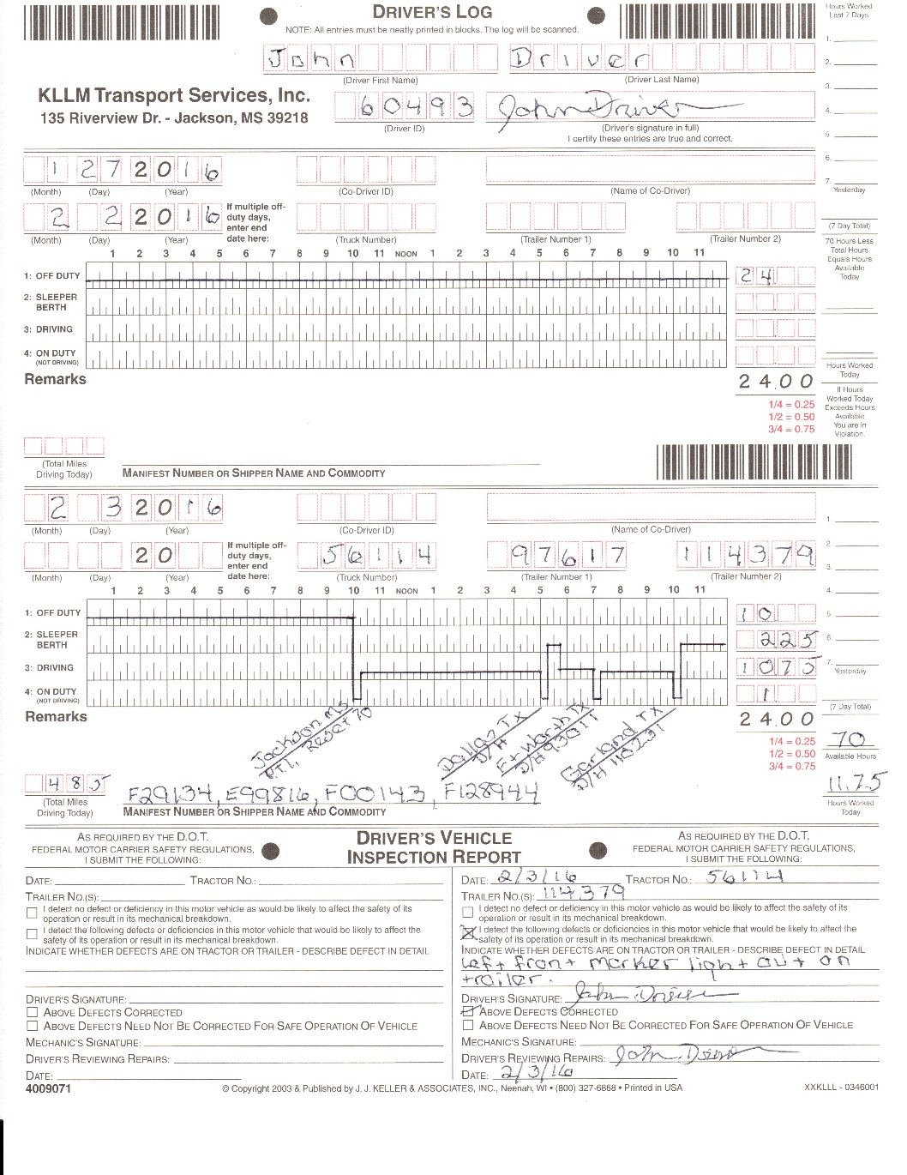
KLLM LOG ORIENTATION

Slide 2
Introduction
KLLM requires every driver to record his/her duty status for each 24-hour period as required by Federal Motor Carrier Safety Regulations; Part 395 Hours of Service.
During this orientation you will be instructed on Hours of Service as well as KLLM Log Policies.

Slide 3
Agenda
Driving Rules
On-Duty Rules
Off-Duty Rules
Driver’s Record of Duty Status
FMCSA Part 395 HOS
KLLM Progressive Enforcement of FMCSA Part 395 HOS

Slide 4
Driving Rules
8 Hour Rule – No driver shall drive after driving for 8 hours without taking a 30 minute break.
  Driver may remain on duty (not driving) for their breaks.
11 Hour Rule – No driver shall drive more than 11 hours total following at least 10 consecutive hours off duty.
14 Hour Rule – No driver shall drive after having been On-Duty 14 hours following 10 consecutive hours off duty.
70 Hour Rule – No driver shall drive after having been On-Duty 70 hours in any 8 consecutive day period.

Slide 5
Rest Break Changes
The 30 minute break must be done prior to 8 cumulative hours of driving and may be completed in an duty status other than drive.
30 minute rest break can be a combination of any duty status other than drive.

Slide 6
Line 4 Log Entries
Time waiting to be dispatched;
Time inspecting equipment or conditioning a motor vehicle; (yard move status not allowed here)
  Minimum 15 minutes for Pre-trip Inspection
    Done at the start of your 1st driving period each day
    As of 09/11/1992 a copy of the authorization is in the back of your Permit Book
    If a team truck EACH driver must log a 15 min PTI
  On Duty for Truck Fuel and D.E.F.
    ELD’s record REAL time for fueling
      When this period has a drive time before and after fueling it may be less than 15 minutes.
    Reefer fuel doesn’t need to be logged when purchased without any Tractor fuel or DEF.
  Pre-trip & fueling may be combined for a total of 15 minutes (If done at the start of your 1st driving period)
Notes:
You can combine on duty not driving activities
Pre-trip & Fueling – 15 minutes
Pre-trip & Load/Unload – 30 minutes
Pre-trip & Drop/Hook – 15 minutes
Fuel & Drop/Hook – 15 minutes (only at a KLLM Terminal)

Slide 7
Line 4 Log Entries Continued
All time loading and unloading, or assisting with the loading and unloading, or remaining in readiness to operate a motor vehicle;
  Off duty line cannot be used on a shipper or receiver’s property.
  ELD’s offer a special condition duty status at a customer – YARD MOVE
    Select – ON DUTY – YARD MOVE – REMARK
    Yard move initiates at 5 MPH instead of the Drive Line
    Yard move deactivates manually, at 20 MPH or by B.O.T. or E.O.T.
  Unload/reload at the same facility
    You will use your Yard Move as necessary at the customer

Slide 8
Line 4 Log Entries Continued
  Minimum 15 minutes for drop & hook
  Yard Move may be used in place of 15 minute on-duty period
  This includes the inspection of the new trailer.
  Yard move for multiple live load/unload you must notate the stop sequence in the remarks.

Slide 9
What must be done if you are “FORCED” to drive to a Safe Haven from a customer?
When you are forced to leave the property of a shipper / receiver you may utilize Personal Conveyance to drive to the nearest Safe Haven.
If the nearest Safe Haven has no available parking FMCSA recommends that the driver annotates on the HOS if he/she cannot park at the nearest location and must proceed to another location.
Moving a CMV at the request of a Federal, State or Local Law Enforcement Official to relocate the CMV during the 10-hour break period. However, the CMV must be moved no farther than the nearest reasonable and safe area to complete the rest period.

Slide 10
What must be done if you are “FORCED” to drive to a Safe Haven in violation because of circumstances or events you have NO control of?
Personal Conveyance CANNOT be used for this.
An example is if the highway is shut down due to an accident etc. or any other circumstance that was beyond your control.
You must annotate the log with the event / circumstance that will cause them to violate HOS to reach the Safe Haven. PRIOR to the violation occurring.
This should include an accurate location:
  Hwy, mile marker, exit # etc..
Poor or lack of trip planning is not excusable by a note. The note MUST be factual. You should have known when and where they were going to finish their day. Any attempt to park prior to the end of HOS, should be annotated on your log.

Slide 11
On-Duty Continued
All time spent performing driver requirements at the scene of an accident and in preparing reports relating to an accident; (involvement with any Law Enforcement Officer)
D.O.T. Inspection (actual time on officers report)
ALL DRUG / ALCOHOL TESTING (all travel and wait time)
  To include ALL random and post accident tests
All time spent repairing or attending to your disabled motor vehicle on the side of the road.
  Off Duty cannot be used here
Notes:
Post accident alcohol & drug testing – to & from collection site.
Random alcohol & drug testing – to & from collection site.

Slide 12
All other time is considered break time on either:
Off-Duty (Line 1)
or
Sleeper Berth (Line 2)

Slide 13
Off-Duty Time
Single Driver
10 Consecutive Hours Off-Duty
10 Consecutive Hours in the Sleeper Berth
10 consecutive hours combination of Sleeper Berth and Off-Duty times.
  This can be used on calculating your 30 minute break or your 34hr restart.

Slide 14
Off-Duty Time Team Drivers
This will allow a co-driver to take a combination of at least 7 consecutive hours of Sleeper Berth time and up to 3 hours riding in the passenger seat as Off Duty before or after the Sleeper Berth time to total 10 consecutive hours.
While the co-driver is still Off Duty, the Change Status screen will remind the driver that the sleeper berth is required.

Slide 15
Split / Sleeper Berth Provision
Before considering the split sleeper Provision the only benefit to using the split sleeper is arriving at a location 2 hours earlier than you would have, had you just taken a 10 hour break.
Commercial motor vehicle drivers using the split sleeper berth provision must take at least 7 consecutive hours in the sleeper berth, plus 3 consecutive hours either in the sleeper berth, off-duty, or any combination of the two.
  The driving time in the period immediately before and after each rest period, when added together, does not exceed 11 hours; and
  All time on any line before and after each rest period, when added together, may not include any driving after the 14th hour
Drivers may choose to go off duty / sleeper for 2 or more hours when delayed, so they can pause the 14 hour clock – as long as they will PAIR a 7 hour sleeper later in the day.

Slide 16
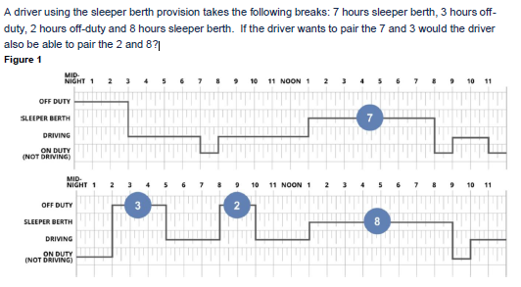
Split / Sleeper Berth Pairing

Slide 17
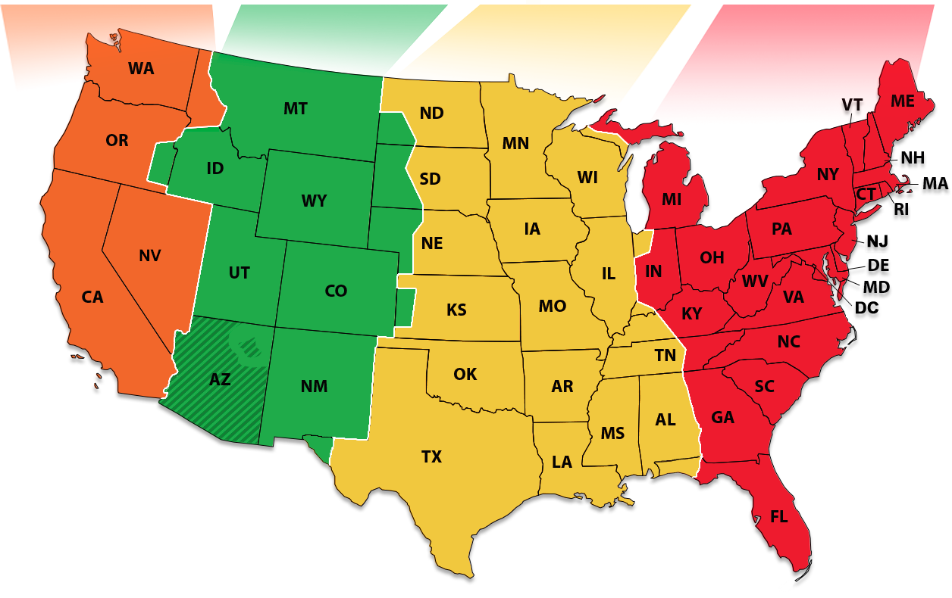
Log Central Standard Time

Slide 18
Driver’s Record of Duty Status
Use medium point, black or blue ink pen
Make entries neat and legible
Both log days must be completed on the 2-day log sheets
Driver’s signature required immediately after all required entries have been made for the 1st-24 hour period on the 2-day log sheet
Do not turn in “voided” or “blank” logs

Slide 19
How to enter NEAT, ACCURATE AND COMPLETE log entries!!
Numeric Entries
  Must be neat legible
  All blank boxes must be at the beginning of the numeric sequence
  If a box has no numeric value leave the box empty.

Slide 20
Driver’s Record of Duty Status
For multiple off-duty days – date the log the first day you are off-duty for 24 hours and also enter the end date.
A log is required for everyday to include off-duty days

Slide 21
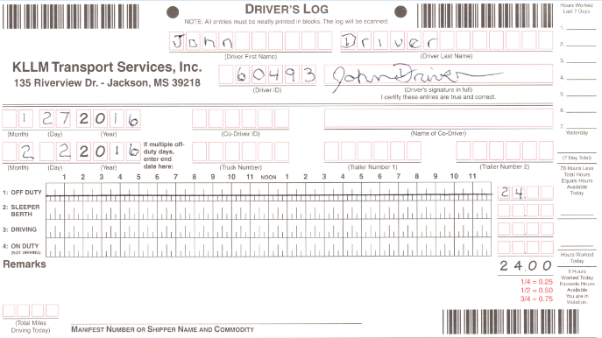
Driver’s Record of Duty Status
Notes:
No recap is required for Off-Duty log.
No Vehicle Inspection report is required for Off-Duty log.

Slide 22
Record of Duty Status
LEAVE ANY EMPTY BLOCKS AT THE BEGINNING OF AN AREA
PRINT NAME LEGIBLE FROM LEFT TO RIGHT
PAYROLL NUMBER IS YOUR LOG ID

Slide 23
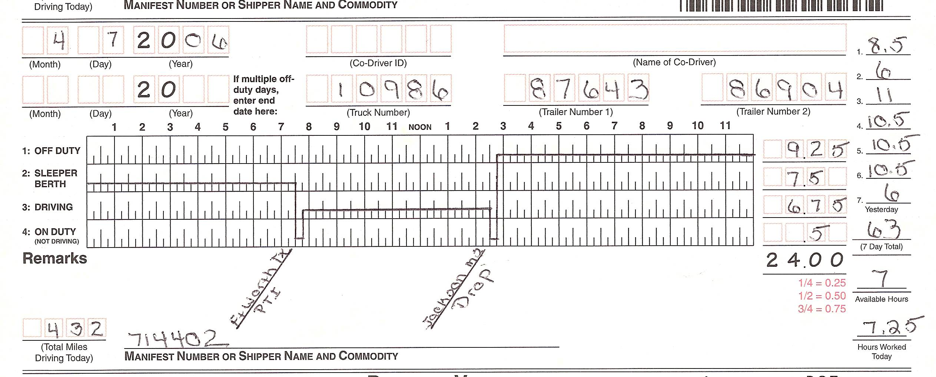
Record of Duty Status
RECAPPING IS REQUIRED BY KLLM COMPANY POLICY
4 thing you should know at any given time:
How many hours are left on the 70?
What time is your 30 minute break need to be done?
What time does the 14 hour clock expire?
What is my ETA to my next destination?

Slide 24
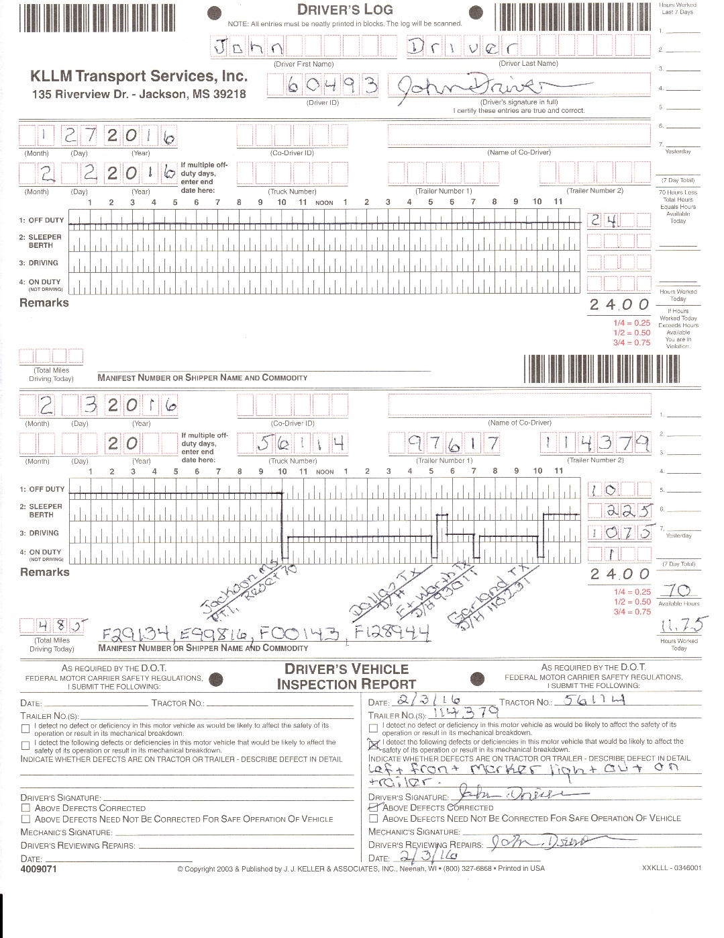
Driver’s Record of Duty Status
1ST TRAILER #
DATE
TRUCK #
2ND TRAILER #
FOR 3 OR MORE TRAILERS NOTE IN REMARKS

Slide 25
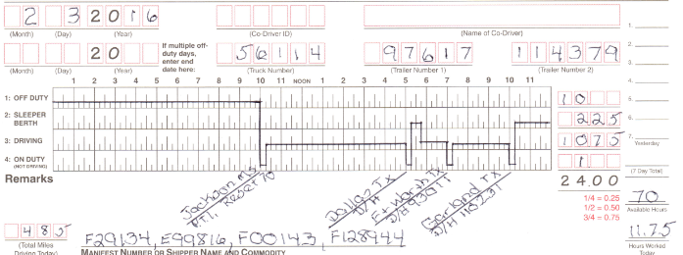
Record of Duty Status
ENTER YOUR TOTAL MILES DRIVING TODAY HERE
F29134; 01258741 – E25632;854785 – F25852;658963
If no driving time is shown for that day, leave mileage boxes BLANK

Slide 26
Record of Duty Status
ENTER YOUR TRIP # OR #’S HERE
F29134; 01258741 – E25632;854785 – F25852;658963
This will be your KLLM order / trip # and B.O.L.

Slide 27
Record of Duty Status
QUIZ
N12354; 256314

Slide 28
Record of Duty Status
THE ANSWER IS NO.
THE RULES STATE THAT ONCE YOU REACH 70 HOURS YOU CAN NOT DRIVE ANYMORE.
THE DRIVER HAD STOPPED DRIVING AFTER REACHING THE 70 AND THEREFORE WAS NOT IN VIOLATION.
IN THIS EXAMPLE THE DRIVER HAD 7 HOURS AVAILABLE TODAY & LOGGED 7.25 HOURS.
IS THIS DRIVER IN VIOLATION OF THE 70 HOUR RULE?
N12354; 256314

Slide 29
Record of Duty Status
WHEN YOU RESET YOUR 70 HOURS ( 34 CONSECUTIVE HOURS OFF-DUTY) COMPLETE THE RECAP AS SHOWN & SHOW IN REMARKS “RESET 70”
F29134; 01258741 – E25632;854785 – F25852;658963
Notes:
The 34 Hour Reset can be a combination of Off-Duty & Sleeper Berth.

Slide 30
Driver’s Record of Duty Status
USE A RULER OR STRAIGHTEDGE TO DRAW YOUR LINES IN THE MIDDLE OF EACH ZONE.
KEEP YOUR DUTY STATUS CURRENT TO THE LAST DUTY STATUS CHANGE.TO INCLUDE NEAREST CITY OR TOWN & STATE.
F29134; 01258741 – E25632;854785 – F25852;658963
Notes:
Draw lines in the middle of each zone.
Do not use fractions, instead use decimals
15 mins. = ¼ = .25
30 mins. = ½ = .5
45 mins. = ¾ = .75
Total Hours – Must equal total 24 hours

Slide 31
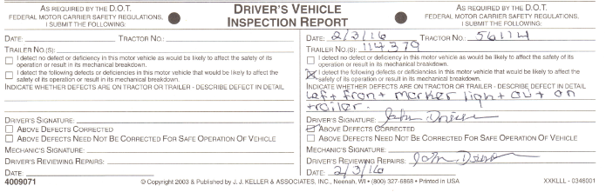
Driver’s Record of Duty Status
Vehicle Inspection Report

Slide 32
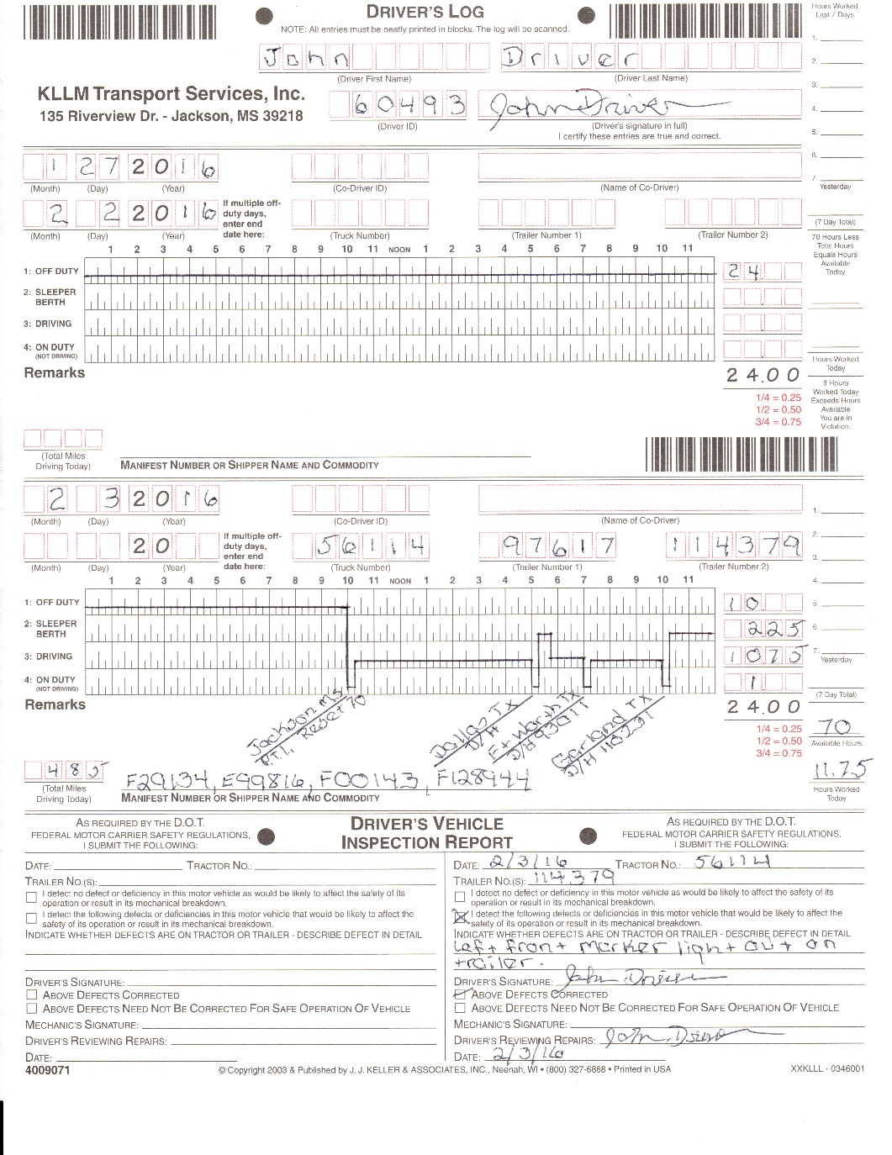
Record of Duty Status
YOUR COMPLETED 2 DAY LOG

Slide 33
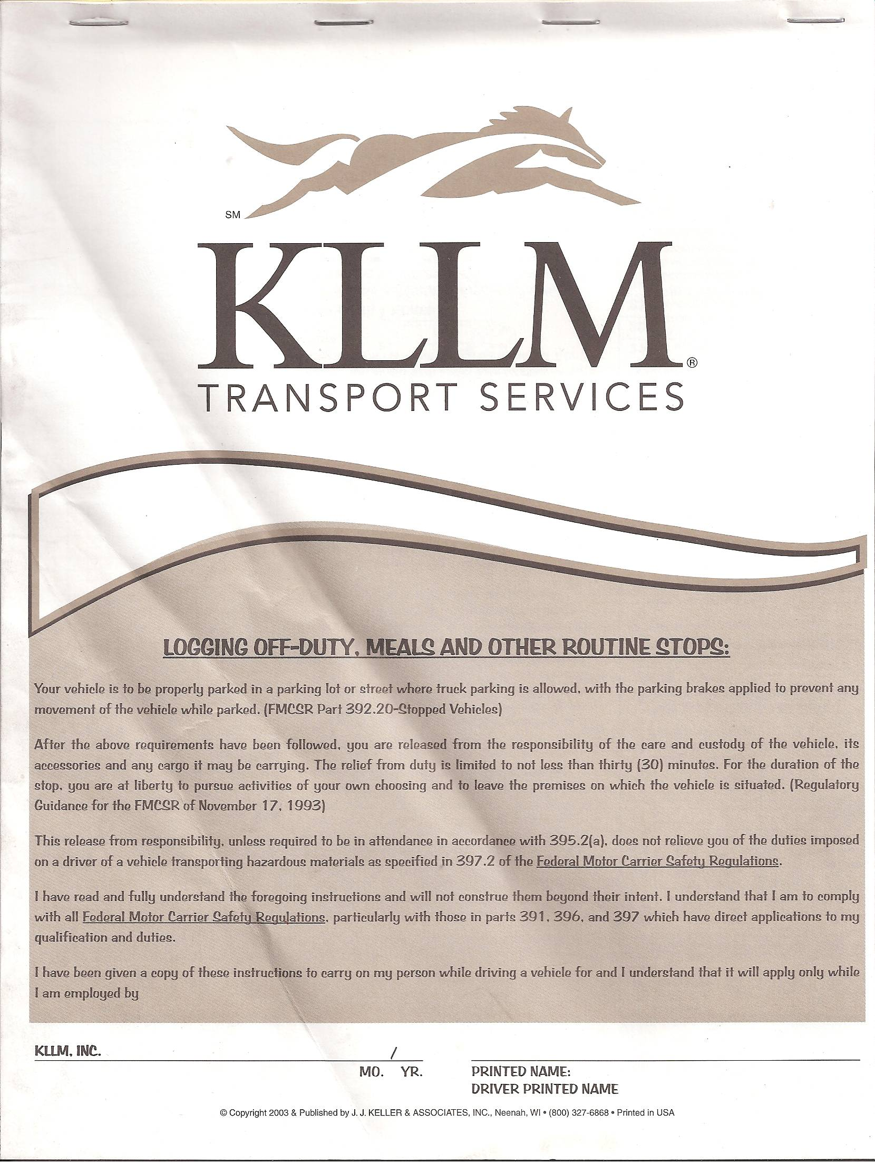
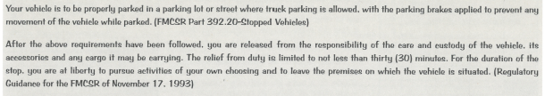
A cover of the KLLM log book must be kept at all times.
In the event that you are running low on blank logs, make copies to hold you over until you can get to a terminal.
Your log image is kept on file for 6 months only. By both RAIR and OMNITRACS.
The driver is responsible for obtaining his/her own logs to keep on record for tax purposes.
It is the drivers responsibility to make sure 8 blank graphs are in your position.

Slide 34
Driver’s Record of Duty Status
100% of driver’s logs will be audited by date, time & location for the following On Duty required entries:
  Post / Pre-trip (Required at start of first driving period after any break of 10 hours or more. Must meet a minimum time of 15 minutes.)
  Fuel
  DOT Inspections
  Accidents & Damage Claims
  Random & Post Accident Alcohol and Drug Testing

Slide 35
H.O.S. Alerts
The elog works with the ECM and GPS to notify Safety of H.O.S. violations.
If no violation is found or driver has properly noted why he/she was forced into violation. The driver will NOT be contacted.
If a violation is found the driver will be instructed to shut down and contact safety immediately.
At this time the driver will be counseled: to include, instruction on what break to take to make him/her legal to drive again, 1 safety point issued at a minimum.
For serious and willful disregard of rules and regulations the driver will be subject to further disciplinary action up to and including DISQUALIFICATION.

Slide 36
LOG VIOLATIONS
Hours of Service
Falsification
The #1 reason for receiving these violations is poor trip planning on the drivers part.
The 2nd reason is not reading/listening to what the unit is telling you and continue to drive.
The 3rd reason is not being able to edit your OWN logs.

Slide 37
Hours of Service
8 Hour Rule
11 Hour Rule
14 Hour Rule
70 Hour Rule
2 or more violations in a 30 day period will result in the driver being moved up 1 level in our Enforcement of FMCSA Part 395 HOS.

Slide 38
Falsification
Pre-Trips
Fuel Stops
Failure to log 5 or more within a 30 day period at the correct time & date will result in driver being moved up 1 level in our Enforcement of FMCSA Part 395 HOS.

Slide 39
Falsification
Dot Inspections
Accidents
Alcohol & Drug Testing
Failure to log 1 or more within a 30 day period at the correct time & date will result in driver being moved up 1 level in our Enforcement of FMCSA Part 395 HOS.
Notes:
Driver’s Handbook on page 75 states “A driver who gives false statements or submits false log entries to KLLM regarding hours of service available for any given dispatch day, and, who, through an audit of the driver’s manifests/records of duty status, or by other means, is discovered to have falsified such information, may be terminated immediately upon discovery at the discretion of KLLM”.

Slide 40
ELD Form & Manner
Form & Manner can only occur when you enter the wrong info or it is missing:
  Load ID #
  BOL #
  Trailer #

Slide 41
ELD Daily Certification Requirement
Keep your logs Certified to with in 24 hours of current date and time.
This will prevent the device from restricting your ability to start work or edit the ELD.

Slide 42
HOS Violations Continued
For serious and willful disregard for rules, regulations, and FMCSA part 395 HOS, the driver may be required to sign a Letter Of Commitment (company driver) or a Notice of Contract Violation (I/C).
Or the driver may be Disqualified immediately.

Slide 43
Progressive Enforcement of FMCSA Part 395 HOS

Slide 44
LEVEL 1
Progressive Enforcement of FMCSA Part 395 HOS
Written warning to the driver via Omnitracs.
If you understand the violations and don’t require any counseling just send a macro 62 to accept the violation.
If you DO NOT understand what caused these violations, please contact the Log Dept. for help.
No points added to Safety Point System.
  DO NOT CALL THE SAFETY DEPT. WHILE YOU ARE DRIVING!!

Slide 45
LEVEL 2
Progressive Enforcement of FMCSA Part 395 HOS
Driver notified via Omnitracs to contact the Log Audit Department
Driver counseled by phone.
No points added to Safety Point System

Slide 46
LEVEL 3
Progressive Enforcement of FMCSA Part 395 HOS
Driver routed to Jackson, Atlanta or Lancaster terminal(s) for counseling.
Re-Training
1 point added to Safety Point System
  The Safety Point System will be discussed later in Orientation.

Slide 47
LEVEL 4
Progressive Enforcement of FMCSA Part 395 HOS
Driver routed to Jackson, Atlanta or Lancaster Terminal for full safety review
Re-Training
1 point added to Safety Point System
Overall safety review is done.
A letter of commitment or NCV will be signed.

Slide 48
Violations Beyond Level 4
Will result in further disciplinary action up to and including driver disqualification

Slide 49
E#####
O#####

Slide 50
Immediate action after logging in
After you log in, you may be prompted to review or resolve:
Unassigned Driving (shop movement with vehicle, etc.)
Missing load information for prior days (shop moved vehicle)
Log Certification (must be current within 24hrs)
It is imperative to read and understand the prompts and the potential impact to your logs.

Slide 51
ERODS continued

Slide 52
Log Edits
After the edit is complete, you are prompted to add an edit reason. The edit reason is required is reflected on your logs.
You are then prompted to certify the log updates.
All changes on a log are displayed in accordance with the regulations. This includes the original duty status along with annotations and the new status.
Correction
Update
Error

Slide 53
Create a New Load
This must be done prior to leaving the shipper.
Delivery Date
From the Load tab, tap New Load.
Enter Load ID (Trip / Pro Number) and Trailer information as required by the regulations.
Enter a B/L (bill of lading), if available.

Slide 54
User Manual
For the user manual, go to the Media Manager Tray in the Home Screen App Tray

Slide 55
User Manual cont.
1. A driver must always have a user manual describing how to use the ELD on hand. If the user manual is electronic, the driver must know how to readily access it.
2. Drivers can utilize an in-cab instruction sheet describing the data-transfer mechanisms supported by the ELD and step-by-step instructions to produce and transfer their Hours of Service (HOS) records to an officer (eRODS).
3. Drivers can use an in-cab instruction sheet for ELD malfunction reporting and recordkeeping requirements during an ELD malfunction; this sheet may be combined with the eRODS transfer instruction sheet.
4. A supply of blank Records of Duty Status graph-grids are sufficient for recording drivers' required HOS data for a minimum of 8 days.
5. Drivers must only operate with an ELD that is capable of producing and transferring an eRODS file.

Slide 56
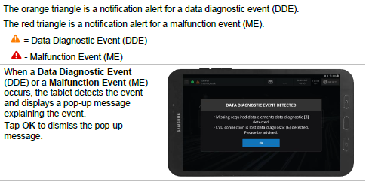
Diagnostic Event
The ELD Data Diagnostic event will not clear because of settings that cannot be changed at this time.

Slide 57
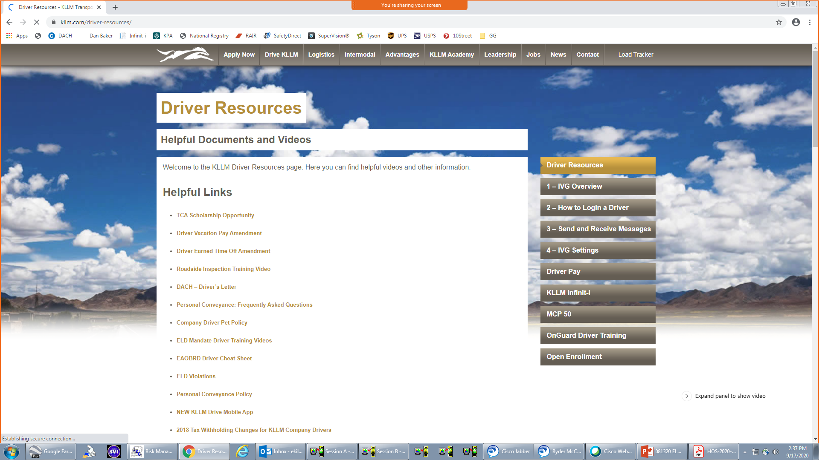

Slide 58
Driver Support
https://www.platformscience.com/customer-support
Platform Science 888-253-0999
Offers 24 / 7 / 365 Driver Support
Log Dept. 800-925-1000 ext. 8022
Hours 08:00 – 17:00 Central Time
7 Days a Week

Slide 59
Driver Guidelines
Never assume the Platform Science is incorrect.
  Call Log Dept. or Platform Science 1st to verify there is an error with the device.
Night Dispatch CAN NOT authorize you to drive with out confirmation from one of the two.
Case # will also have a recording of your phone call to verify Platform Science told you to go to paper log.
You must have a copy of the previous 7 days logs, (either digital or paper) before you can start using paper logs.

Slide 60
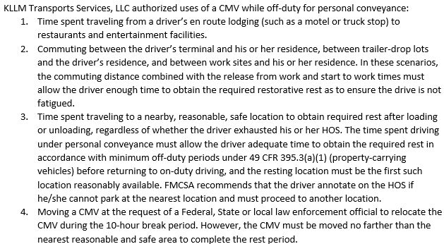
Personal Conveyance

Slide 61
Misuse or abuse of Personal Conveyance will result in disciplinary action up to and including immediate DISQUALIFICATION!!!
  1st Offense results in immediate lose of PC for a minimum of 3 weeks. During this time if the driver has a legitimate need for PC it must be approved by Log Audit or Night Supervisor.
  PC will NOT be reinstated until the driver can verbally explain the PROPER use of PC.
  2nd offense will cause the permanent removal of PC.

Slide 62
Driver “Log Out Policies and Procedures”
Drivers are ONLY allowed to log out when they turn their truck into an authorized service location. Or parking at a KLLM terminal for time off.
All drive time to and from a service location must be logged as On Duty Driving.

Slide 63
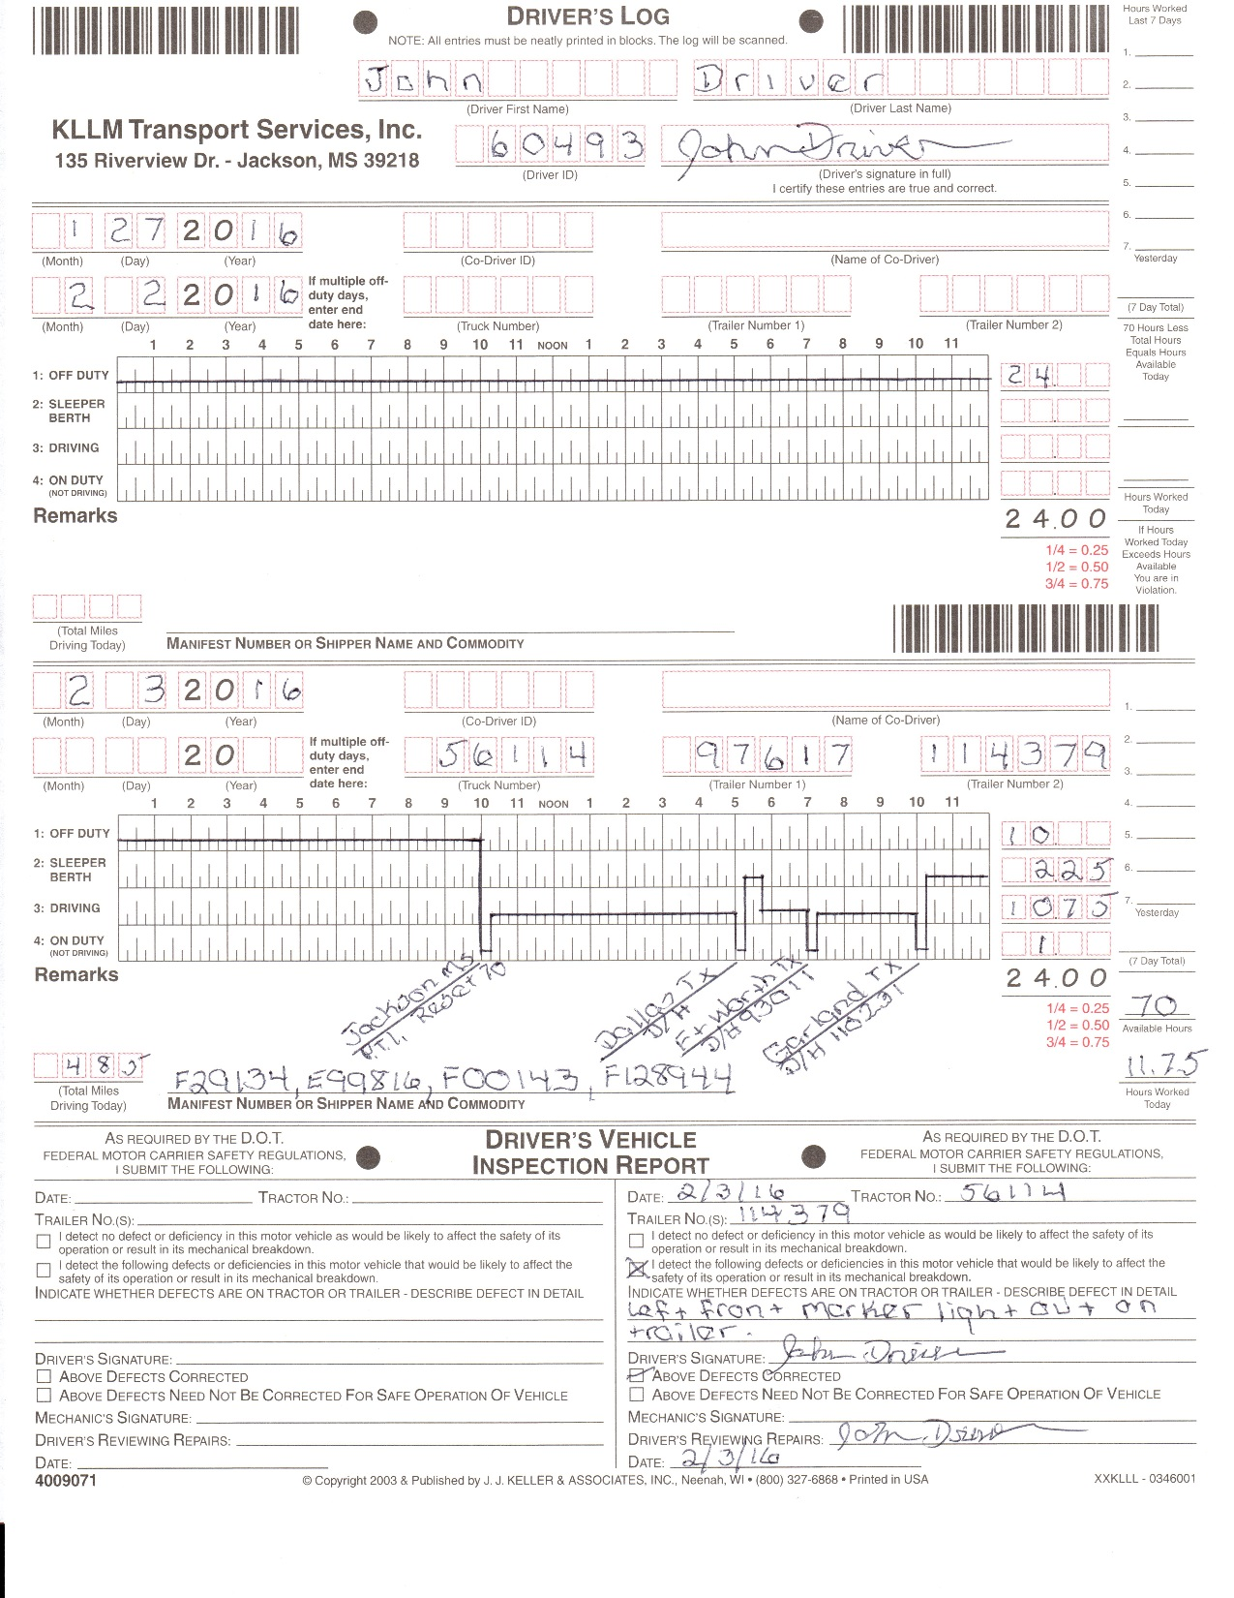
F29134; 01258741 – E25632;854785 – F25852;658963
Notes:
FULL PAGE PRINTING

